Slide 1

by:
Gamma Group

Slide 2
Agenda
Objectives
Motivation
Tools & Technology
Software Process
Development Methodology
Game Walkthrough
Demonstration
Question Period
Notes:
Speaker: Nick

Slide 3
The Idea
Throw an object into a receptacle (but make it fun).
Notes:
Speaker: Nick

Slide 4
Objectives
SHORT TERM
GOAL 1
GOAL 2
Engage users in a fun and interactive physics-based game.
Provide an entertaining and educational escape from boredom.
GOAL 3
GOAL 4
Foster a deeper understanding of object interactions with the environment.
Encourage replayability and skill improvement through level progression and high-score attempts.
LONG TERM
Notes:
Speaker: Nick

Slide 5
Motivation
Why the team chose this project
Problem we are addressing with the game
Target audience for the game
We wanted to create a fun, interactive game that helps users learn about physics while engaging in a stimulating activity.
Anyone interested in learning about physics through interactive gameplay, or those looking for a fun way to pass the time.
Our game helps users develop a better understanding of object interactions with the environment and offers an entertaining escape from boredom.
Notes:
Speaker: Nick

Slide 6







Tools and Technology
Project Management | Programming Languages | Development Libraries
Notes:
Speaker: Shihab

Slide 7
Software Process
Concept and planning
Design and prototyping
Implementation and development
Testing and refinement
Notes:
Speaker: Shihab

Slide 8
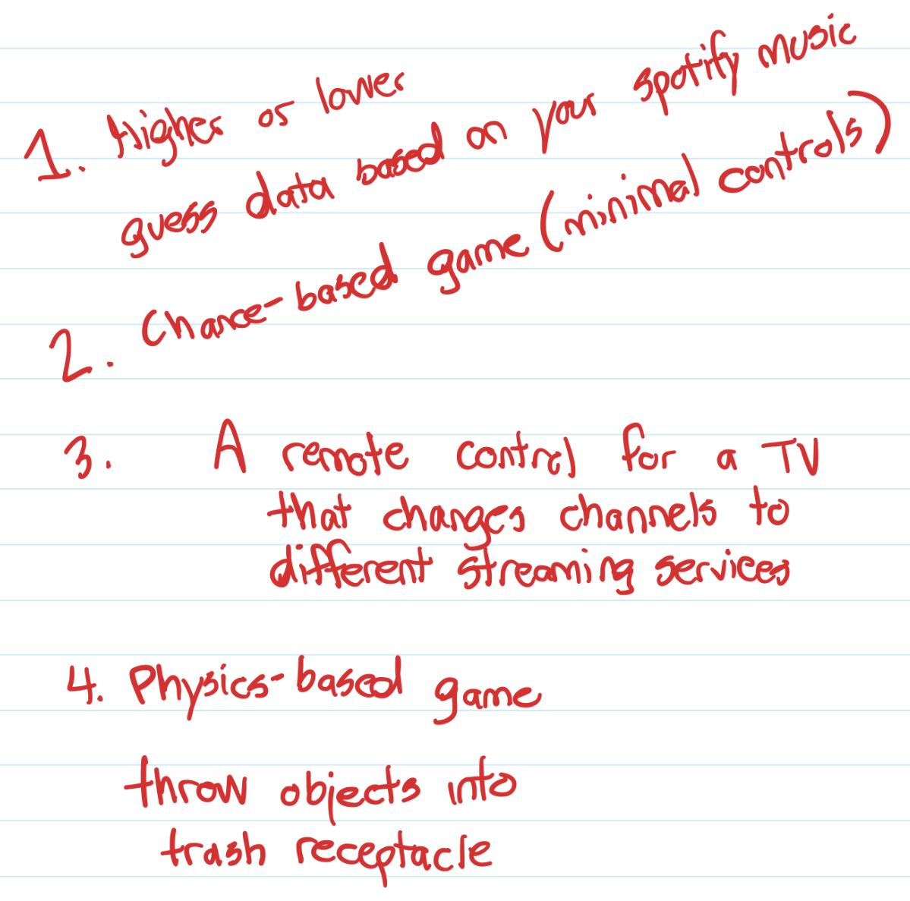
Concept & Planning
Notes:
Speaker: Shihab

Slide 9
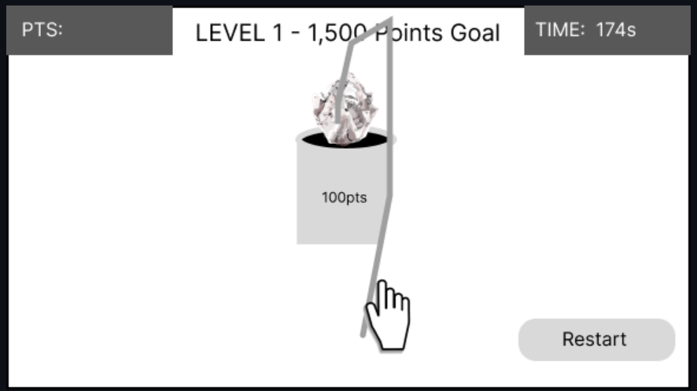
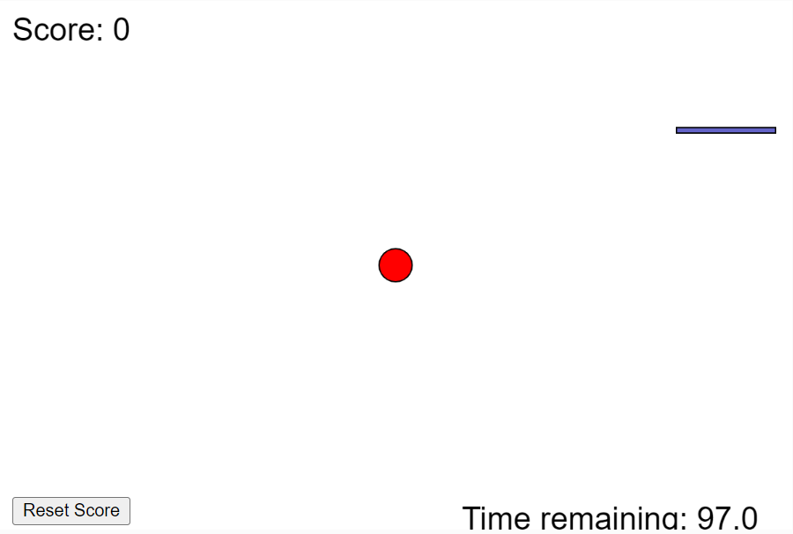
Design & Prototyping
Notes:
Speaker: Shahin

Slide 10
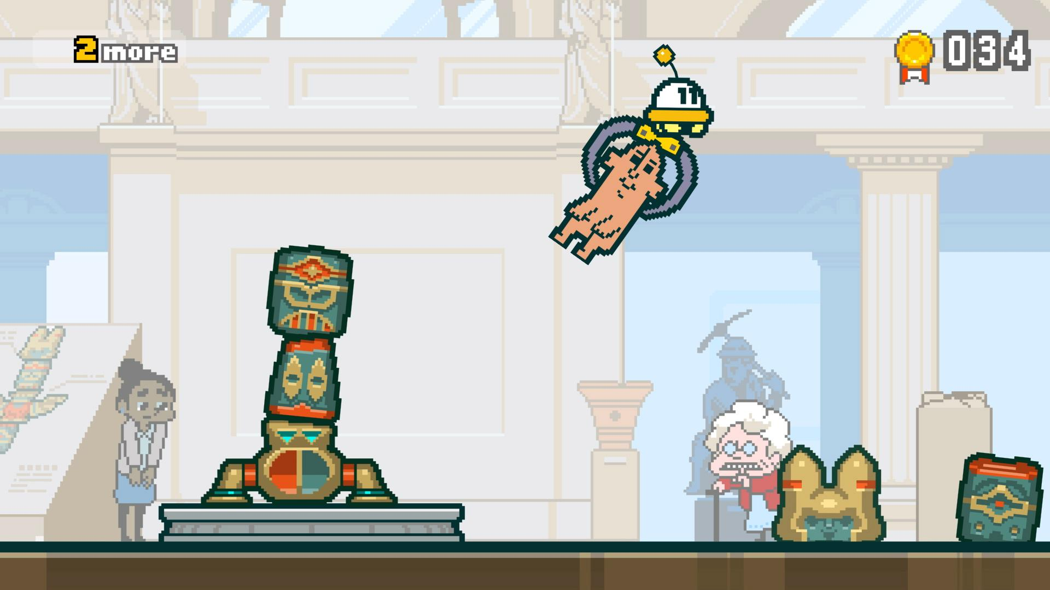


Art and Assets
Tools Used:
Primary inspiration: Part-Time UFO
Notes:
Max: The moment we decided on a physics-based game my mind immediately went to Part-Time UFO. It has this great art style and pastel backgrounds I wanted to emulate. To make the artwork I used Aesprite and Photoshop.

Slide 11





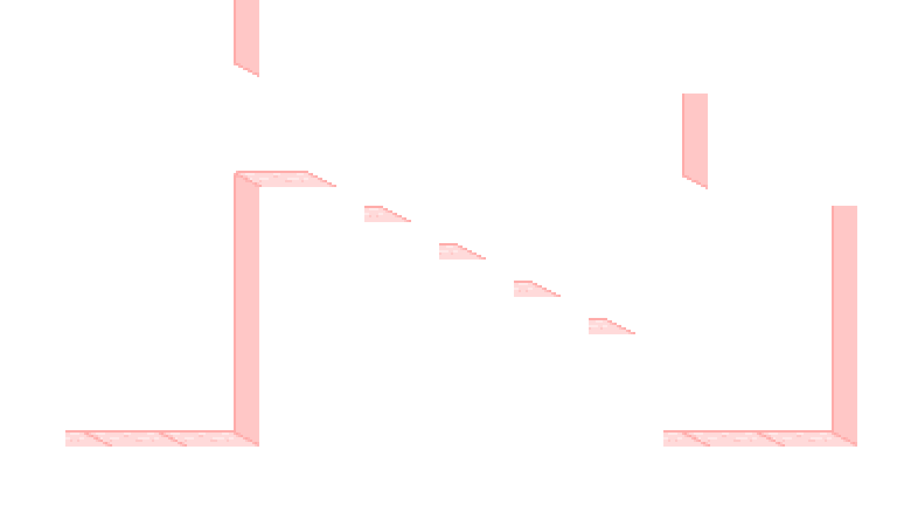
Asset Formatting
BG layer
Coll. layer
FG layer
BG
FG
Notes:
Max: When making the assets, I had to think about layers, whether something should be behind the ball, on the same plane as the ball, or in front of the ball. So most of the assets are split into separate files to be passed to the environment class to the correct position.

Slide 12
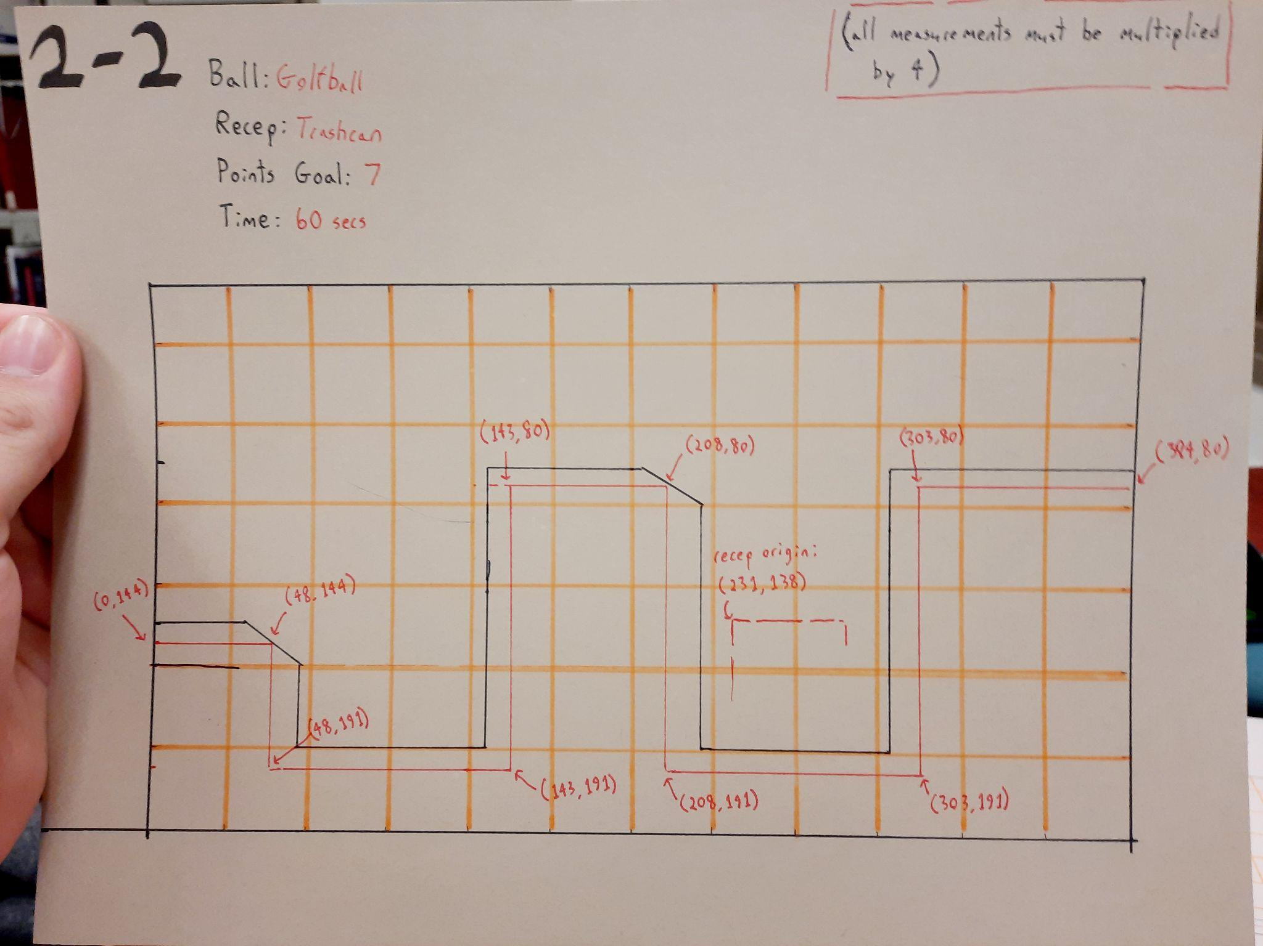
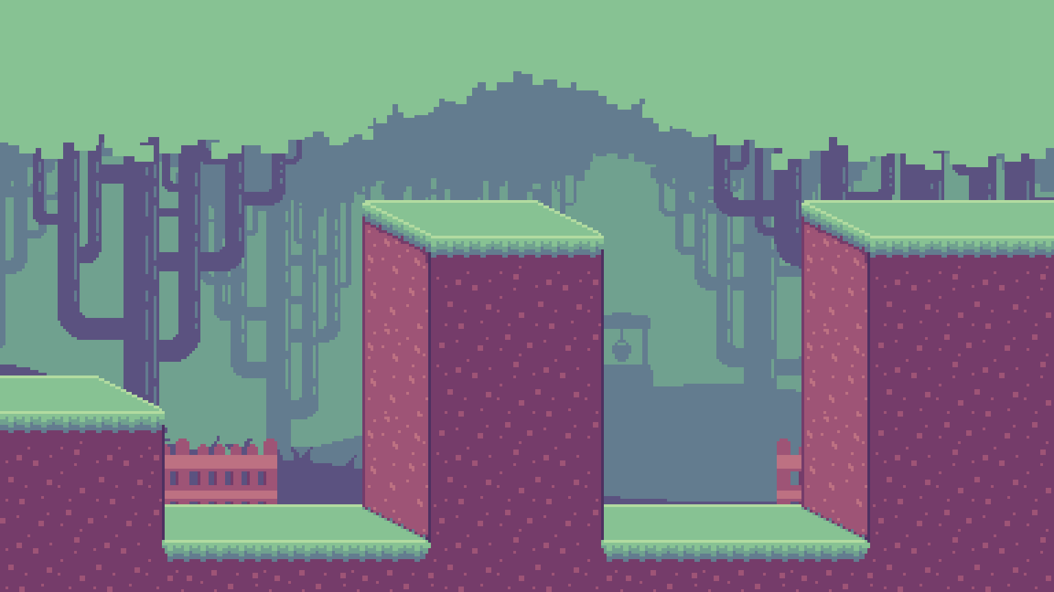
Level Design
Notes:
Max: I made the decision to draw out the levels physically and give the coordinates of the vertices, while at the same time tiling each level. You'll see in the game there are only right angles. I'd like to go back and make better levels that take advantage of the incredible platform class Quoc made.

Slide 13
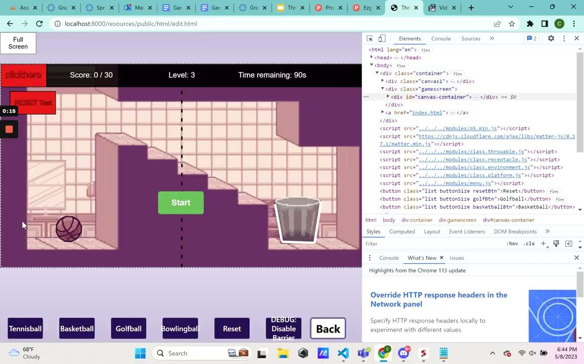
Level Editor
Notes:
Speaker: quoc

Slide 14
Development Methodology
Agile
Regular Team Meetings
Iterative Development
Progress Updates
Notes:
Speaker: Ryan
Used Agile development based on weekly sprints.
Meetings, updates, and communication was integral throughout the development process.

Slide 15
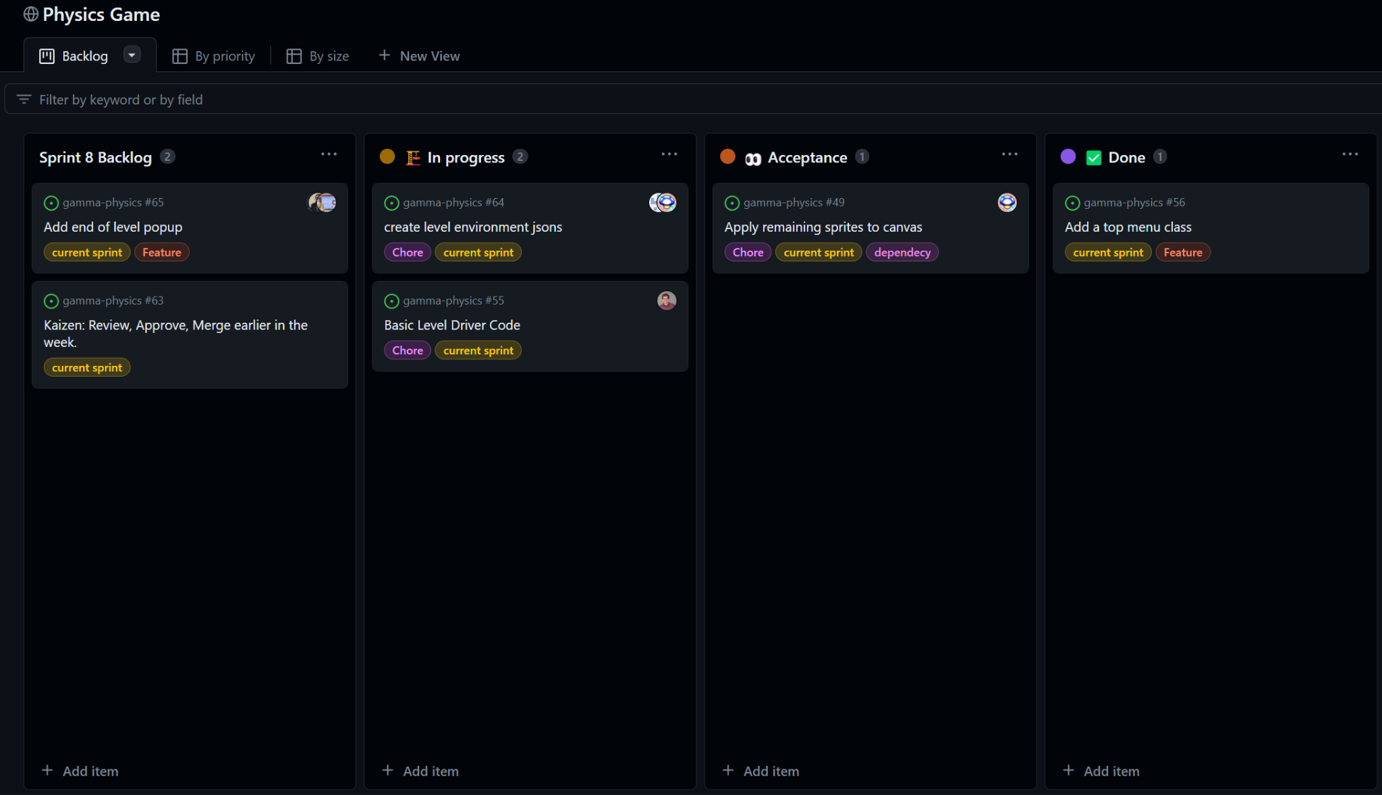
Kanban Board
Notes:
Speaker: Ryan
Week starts with a Kanban board.
Devs assign themselves tasks, and move it to “In Progress” when they begin work

Slide 16
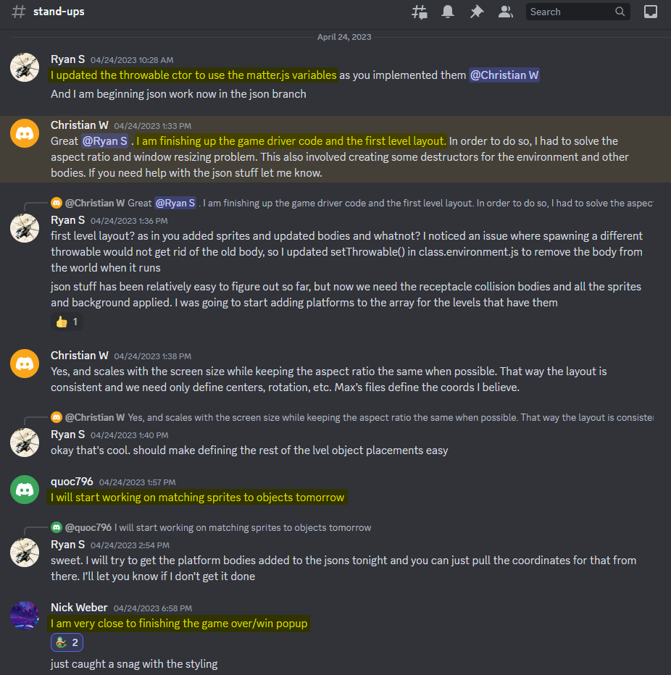
Stand Ups
Notes:
Speaker: Ryan
Daily stand-ups did not fit the nature of our project well.
Development happens at odd times of the week.
So, a dev lets people know when they are working on a task and what they’ve done in the Discord stand-ups channel.

Slide 17
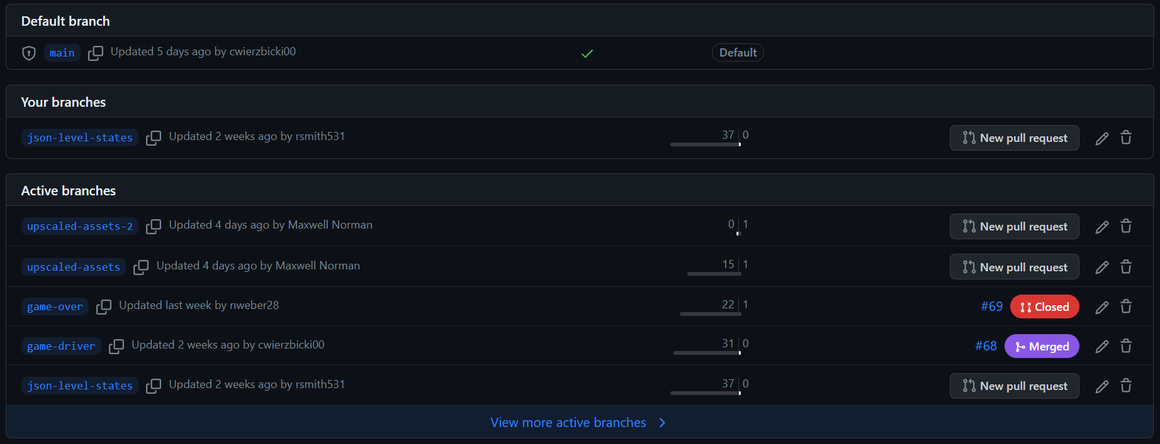
Branching
Notes:
Speaker: Ryan
Once a dev accepts a task, they create a new branch for their work.
Anyone else working the task also works out of this branch.

Slide 18
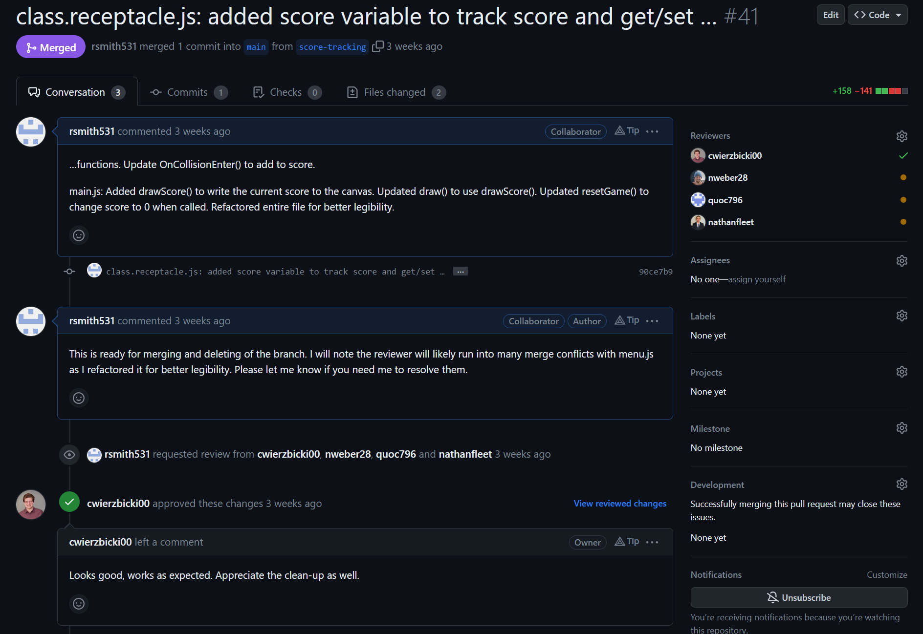
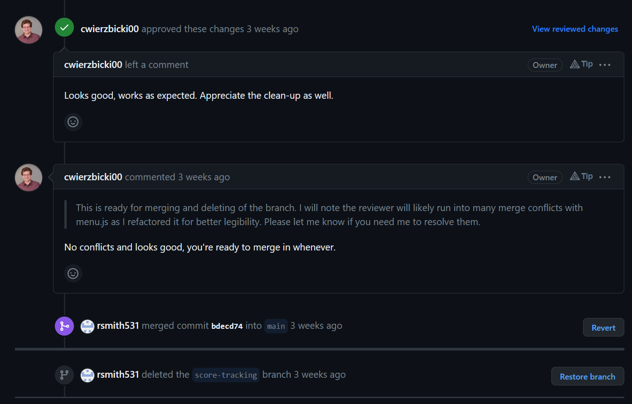
Pull Requests
Notes:
Speaker: Ryan
When the work is ready for review, a pull request is created.
The requestor notifies individuals they would like a review from.
The reviewer approves the merge, the requestor performs the merge and deletes the branch.

Slide 19
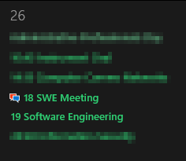
Review, Retrospective, & Planning Meeting
Notes:
Speaker: Ryan
Every Wednesday the team meets, conducts a review of the week where tasks are closed and any remaining branches are handled.
The retrospective begins and we find ways to work together better.
The planning is initiated and new tasks are added to a fresh Kanban for the coming week.

Slide 20
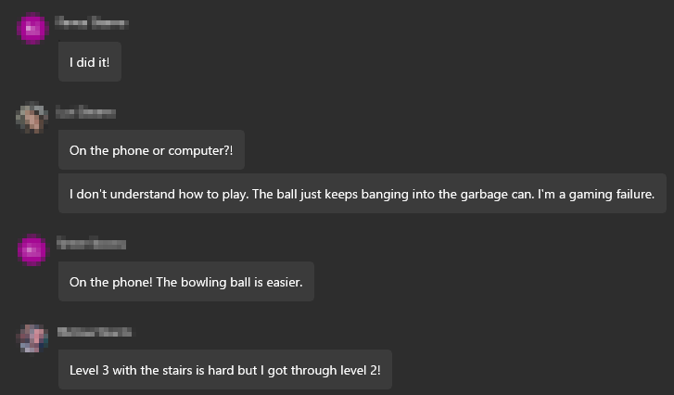
Testing & Refinement
Notes:
Speaker: Micheal

Slide 21
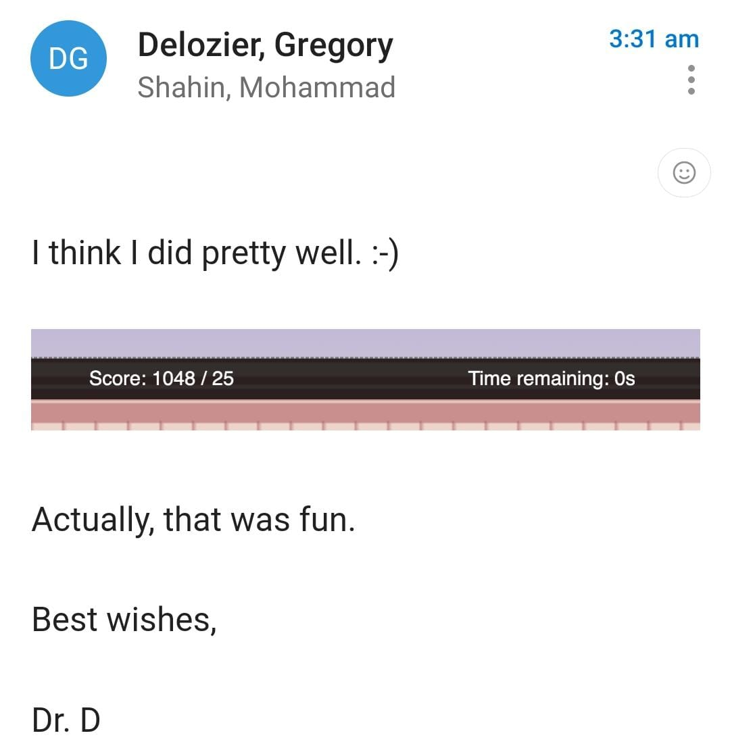
Testing & Refinement
Notes:
Speaker: Micheal

Slide 22
The Game Itself

Slide 23
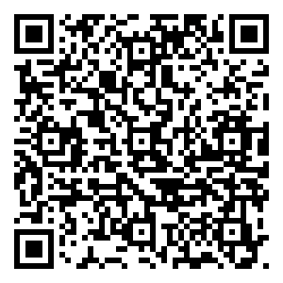
Try it out!
tinyurl.com/throwy
Notes:
Speaker: Shahin

Slide 24
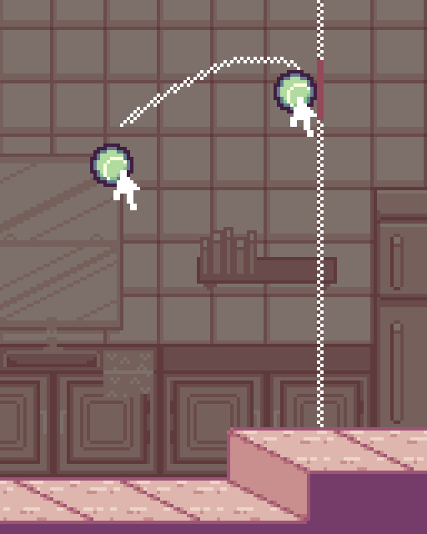
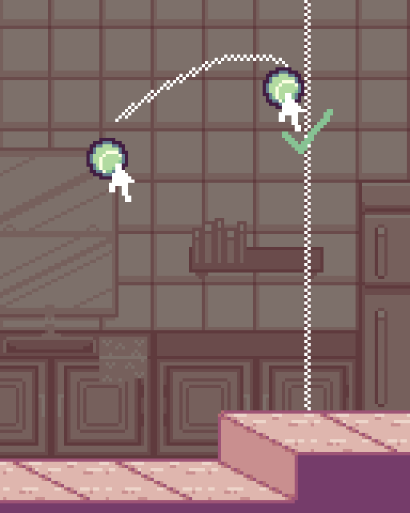
How To Play
Choose a ball. Each ball has a different point value and different physics.
Throw the ball. Click and drag on the ball to move it. Release the ball at the right time. Whether the throw is easier or harder teaches you about physics.
Score points. To move to the next level, you need to get enough points in a certain amount of time.
release
Notes:
Speaker: Shahin

Slide 25
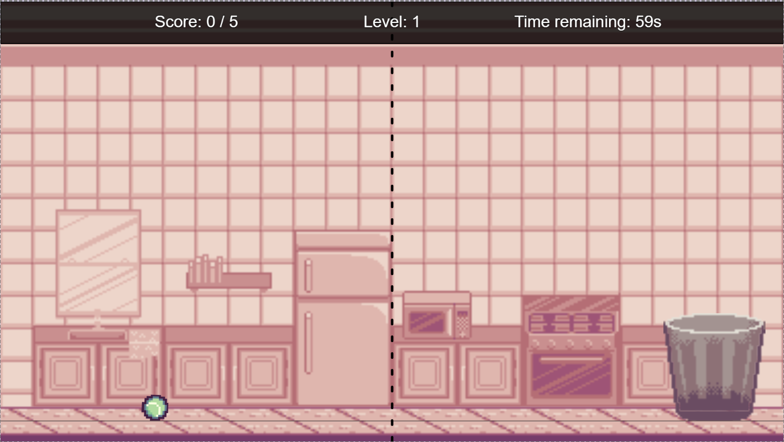
Demo
Let’s give it a go then
Notes:
Speaker: Shahin

Slide 26
Conclusion
Notes:
Speaker: Christian W. Commentary on overall satisfaction w/ the game, what worked, what did not.
Recap main points of the presentation:
-We developed an engaging physics-based game called "Throw It In!"
-Our game educates users about physics through fun, interactive gameplay.
-We used an Agile development process and p5.js for creating the game.

Slide 27
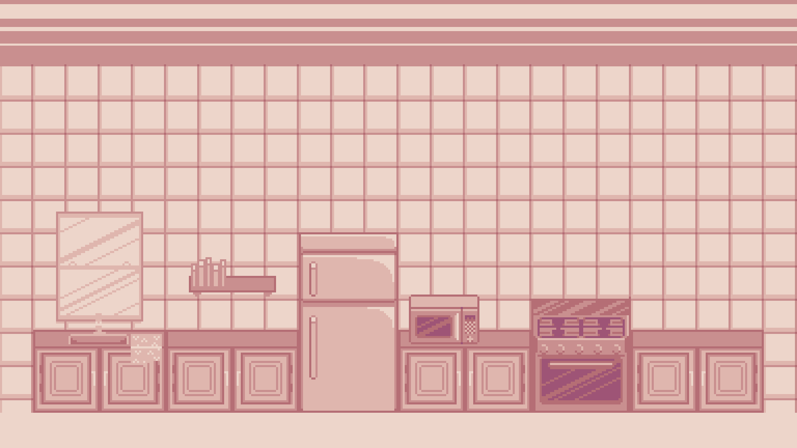

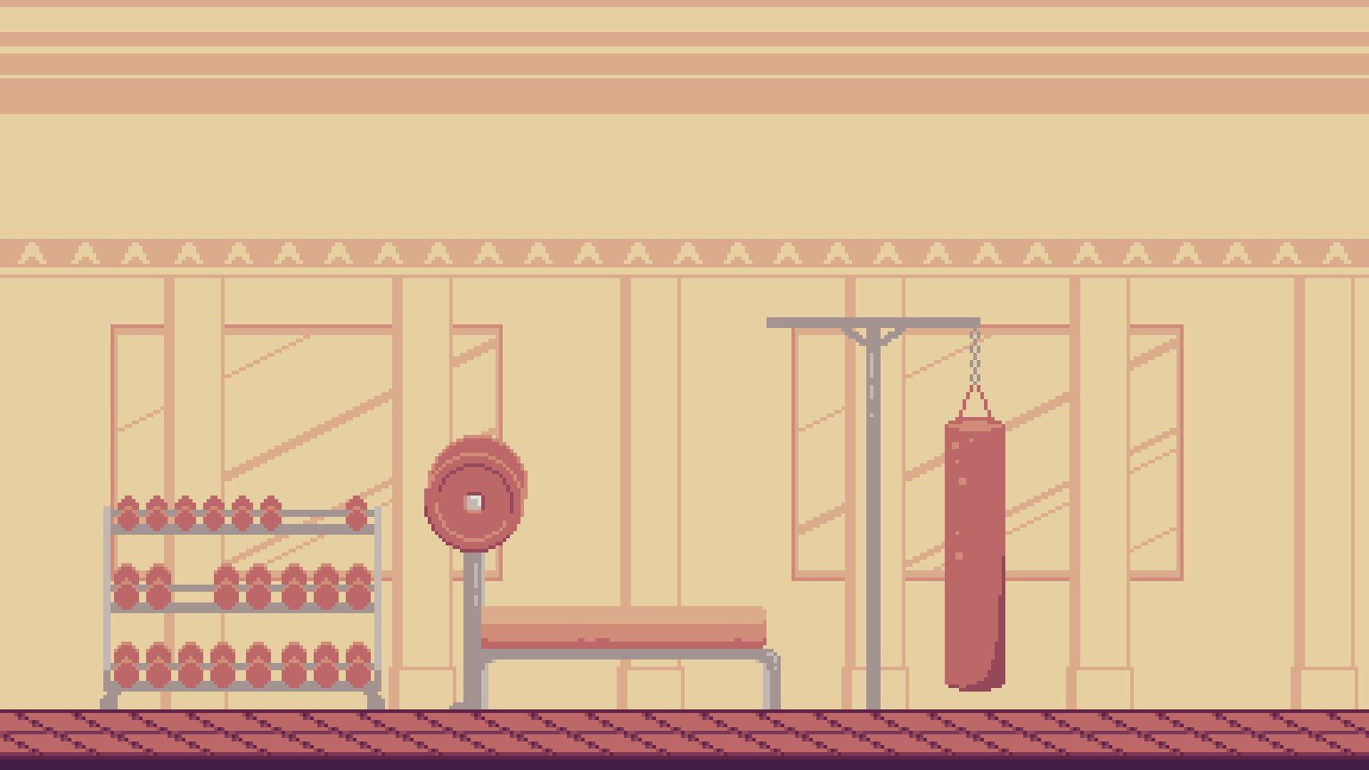
Throw It In! The Future
Clean-up menus & polish design
New levels using level builder
Abilities and rewards
Leaderboard and user sessions
Notes:
Speaker: Christian Future ambitions for the game + video demo of level building
Future plans or improvements for the game:
-Add more levels and challenges to keep the game fresh and engaging.
-Improve the reward system with more unlockables and customization options.
-Continue to refine the gameplay mechanics and user experience based on feedback and testing.

Slide 28
Questions
Thank you for your attention!
We are now open to any questions.
Notes:
Everyone

Slide 29
Throw It In!
Project by Gamma Group
Spring 2023 SOFTWARE ENGINEERING

Slide 30
Development Methodology
Agile / Scrum
Iterative Development
Regular Team Meetings
Progress Updates

Slide 31
Software Process
Concept and planning
Design and prototyping
Implementation and development
Testing and refinement

Slide 32
Tools and Technology
Project
Management
Programming
Languages
Development
Libraries

Slide 33
The Game Itself

Slide 34
How To Play
Choose a ball. Each ball has a different point value and different physics.
Throw the ball. Click and drag on the ball to move it. Release the ball at the right time. Whether the throw is easier or harder teaches you about physics.
Score points. To move to the next level, you need to get enough points in a certain amount of time.
release

Slide 35

Art and Assets
Tools Used:
Primary inspiration: Part-Time UFO
Notes:
Max: The moment we decided on a physics-based game my mind immediately went to Part-Time UFO. It has this great art style and pastel backgrounds I wanted to emulate. To make the artwork I used Aesprite and Photoshop.

Slide 36
Asset Formatting
BG layer
Coll. layer
FG layer
BG
FG
Notes:
Max: When making the assets, I had to think about layers, whether something should be behind the ball, on the same plane as the ball, or in front of the ball. So most of the assets are split into separate files to be passed to the environment class to the correct position.

Slide 37
Level Design
Notes:
Max: I made the decision to draw out the levels physically and give the coordinates of the vertices, while at the same time tiling each level. You'll see in the game there are only right angles. I'd like to go back and make better levels that take advantage of the incredible platform class Quoc made.

Slide 38
Other Experiences (keep making slides)

Slide 39
Conclusion
Recap main points of the presentation:
We developed an engaging physics-based game called "Throw It In!"
Our game educates users about physics through fun, interactive gameplay.
We used an Agile development process and p5.js for creating the game.
Future plans or improvements for the game:
We plan to add more levels and challenges to keep the game fresh and engaging.
We aim to improve the reward system with more unlockables and customization options.
We will continue to refine the gameplay mechanics and user experience based on feedback and testing.

Slide 40
Project Goals
Engage users in a fun and interactive physics-based game.
Foster a deeper understanding of object interactions with the environment.
Challenge users with various levels, objects, and receptacles.
Encourage replayability and skill improvement through level progression and high-score attempts.
Provide an entertaining and educational escape from boredom.
Encourage curiosity and learning about everyday experiences.

Slide 41
Motivation
Why the team chose this project
Problem we are addressing with the game
Target audience for the game
We wanted to create a fun, interactive game that helps users learn about physics while engaging in a stimulating activity.
Our game helps users develop a better understanding of object interactions with the environment and offers an entertaining escape from boredom.
Anyone interested in learning about physics through interactive gameplay, or those looking for a fun way to pass the time.

Slide 42
Questions
Thank you for your attention!
We are now open to any questions.

